Slide 1
Unit-2
By
B R S S RAJU
Asst.Prof
Dept of Computer Science and Engineering
Aditya Engineering College(A)
Surampalem.

Slide 2
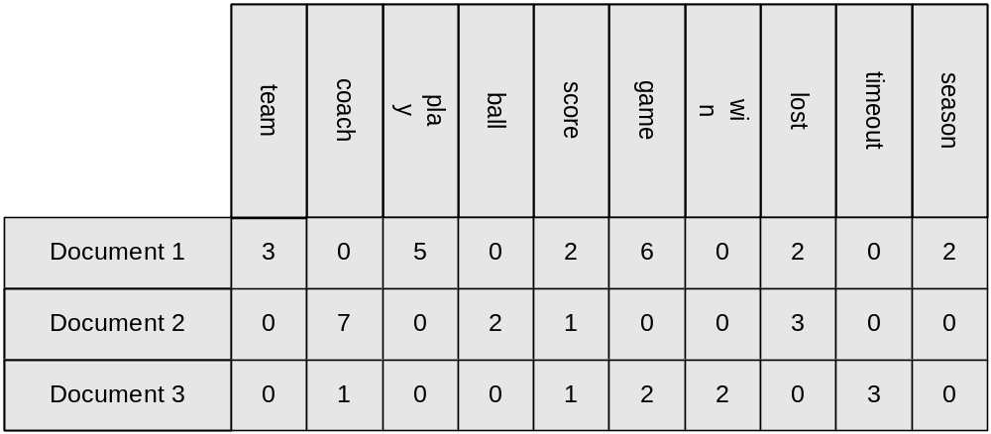

Types of Data Sets
Record
  Relational records
  Data matrix, e.g., numerical matrix, crosstabs
  Document data: text documents: term-frequency vector
  Transaction data
Graph and network
  World Wide Web
  Social or information networks
  Molecular Structures
Ordered
  Video data: sequence of images
  Temporal data: time-series
  Sequential Data: transaction sequences
  Genetic sequence data
Spatial, image and multimedia:
  Spatial data: maps
  Image data:
  Video data:
R S S RAJU BATTULA

Slide 3
Important Characteristics of Structured Data
Dimensionality
  Curse of dimensionality
Sparsity
  Only presence counts
Resolution
  Patterns depend on the scale
Distribution
  Centrality and dispersion
R S S RAJU BATTULA

Slide 4
Data Objects
Data sets are made up of data objects.
A data object represents an entity.
Examples:
  sales database: customers, store items, sales
  medical database: patients, treatments
  university database: students, professors, courses
Also called samples , examples, instances, data points, objects, tuples.
Data objects are described by attributes.
Database rows -> data objects; columns ->attributes.
R S S RAJU BATTULA

Slide 5
Attributes
Attribute (or dimensions, features, variables): a data field, representing a characteristic or feature of a data object.
  E.g., customer _ID, name, address
Types:
  Nominal
  Binary
  Numeric: quantitative
    Interval-scaled
    Ratio-scaled
R S S RAJU BATTULA

Slide 6
Attribute Types
Nominal: categories, states, or “names of things”
  Hair_color = {auburn, black, blond, brown, grey, red, white}
  marital status, occupation, ID numbers, zip codes
Binary
  Nominal attribute with only 2 states (0 and 1)
  Symmetric binary: both outcomes equally important
    e.g., gender
  Asymmetric binary: outcomes not equally important.
    e.g., medical test (positive vs. negative)
    Convention: assign 1 to most important outcome (e.g., HIV positive)
Ordinal
  Values have a meaningful order (ranking) but magnitude between successive values is not known.
  Size = {small, medium, large}, grades, army rankings
R S S RAJU BATTULA

Slide 7
Numeric Attribute Types
Quantity (integer or real-valued)
Interval
    Measured on a scale of equal-sized units
    Values have order
      E.g., temperature in C˚or F˚, calendar dates
    No true zero-point
Ratio
    Inherent zero-point
    We can speak of values as being an order of magnitude larger than the unit of measurement (10 K˚ is twice as high as 5 K˚).
      e.g., temperature in Kelvin, length, counts, monetary quantities
R S S RAJU BATTULA

Slide 8
Discrete vs. Continuous Attributes
Discrete Attribute
  Has only a finite or countably infinite set of values
    E.g., zip codes, profession, or the set of words in a collection of documents
  Sometimes, represented as integer variables
  Note: Binary attributes are a special case of discrete attributes
Continuous Attribute
  Has real numbers as attribute values
    E.g., temperature, height, or weight
  Practically, real values can only be measured and represented using a finite number of digits
  Continuous attributes are typically represented as floating-point variables
R S S RAJU BATTULA

Slide 9
Basic Statistical Descriptions of Data
Motivation
  To better understand the data: central tendency, variation and spread
Data dispersion characteristics
  median, max, min, quantiles, outliers, variance, etc.
Numerical dimensions correspond to sorted intervals
  Data dispersion: analyzed with multiple granularities of precision
  Boxplot or quantile analysis on sorted intervals
Dispersion analysis on computed measures
  Folding measures into numerical dimensions
  Boxplot or quantile analysis on the transformed cube
R S S RAJU BATTULA

Slide 10
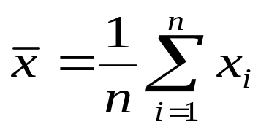


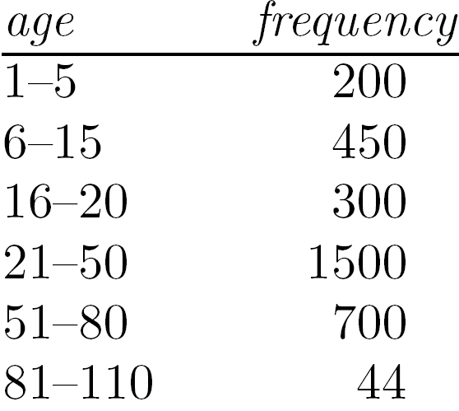
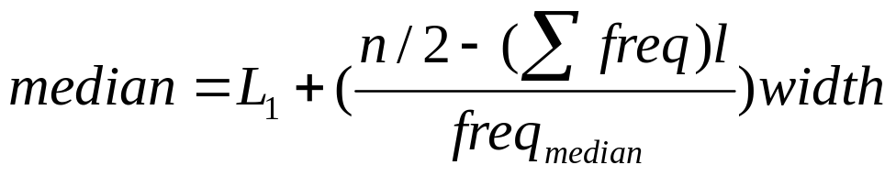
Measuring the Central Tendency
Mean (algebraic measure) (sample vs. population):
  Note: n is sample size and N is population size.
  Weighted arithmetic mean:
  Trimmed mean: chopping extreme values
Median:
  Middle value if odd number of values, or average of the middle two values otherwise
  Estimated by interpolation (for grouped data):
Mode
  Value that occurs most frequently in the data Unimodal, bimodal, trimodal. Empirical formula:
R S S RAJU BATTULA

Slide 11
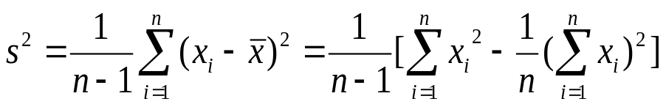

Measuring the Dispersion of Data
Quartiles, outliers and boxplots
  Quartiles: Q₁ (25th percentile), Q₃ (75th percentile)
  Inter-quartile range: IQR = Q₃ – Q₁
  Five number summary: min, Q₁, median, Q₃, max
  Boxplot: ends of the box are the quartiles; median is marked; add whiskers, and plot outliers individually
  Outlier: usually, a value higher/lower than 1.5 x IQR
Variance and standard deviation (sample: s, population: σ)
  Variance: (algebraic, scalable computation)
  Standard deviation s (or σ) is the square root of variance s² ⁽or σ²⁾
R S S RAJU BATTULA

Slide 12
Graphic Displays of Basic Statistical Descriptions
Boxplot: graphic display of five-number summary
Histogram: x-axis are values, y-axis repres. frequencies
Quantile plot: each value x_{i} is paired with f_{i} indicating that approximately 100 f_{i} % of data are ≤ x_{i}
Quantile-quantile (q-q) plot: graphs the quantiles of one univariant distribution against the corresponding quantiles of another
Scatter plot: each pair of values is a pair of coordinates and plotted as points in the plane
R S S RAJU BATTULA

Slide 13
Similarity vs Dissimilarity
A similarity measure for 2 objects, i and j
Returns 0, if they are unlike
1, if they are alike
The higher the similarity value, the greater the similarity between objects.
1, indicates complete similarity.
R S S RAJU BATTULA

Slide 14
A Dissimilarity measure for 2 objects, i and j
Returns 0, if they are alike
1, if they are unlike
The higher the similarity value, the greater the similarity between objects.
1, indicates complete dissimilarity.
R S S RAJU BATTULA

Slide 15
Data Matrix VS Dissimilarity Matrix
Suppose that we have n objects (ex: person, items or courses) described by p attributes (ex: age, weight, height, complexion, hobbies, skills and gender).
The objects are x1=x11,x12,x13…..x1f…..x1n.
x2=x21,x22,x23….x2f……x2n and so on.
Where Xij is the value for the object Xi of the jth attribute.
x11……x1f……x1p
……………………
xi1……xif…….xip
…………………….
xn1……xnf…….xnp
Then the Data Matrix:
R S S RAJU BATTULA

Slide 16
Dissimilarity Matrix (object-object Structure)
This structure stores all proximities that are available for all pairs of n objects.
0
d(2,1) 0
d(3,1) d(3,2) 0
d(4,1) d(4,2) d(4,3) 0
……. …….. ……. …..
……. …….. ……. …..
d(n,1) d(n,2) d(n,3) … 0
Dissimilarity Matrix:
i.e ., sim(i,j)=1-dis(i,j)
R S S RAJU B ATTULA

Slide 17
Proximity measures for Nominal Attributes
A Nominal Attribute can take two or more states. Let the number of states for nominal attribute be M. Such as 1,2,3,….,M.
p-m
m is number of matches.
p is number if attributes.
Then, dissimilarity:
d(i , j) =
p
0
d(2,1) 0
d(3,1) d(3,2) 0
d(4,1) d(4,2) d(4,3) 0
……. …….. ……. …..
……. …….. ……. …..
d(n,1) d(n,2) d(n,3) … 0
Let us compute, dissimilarity matrix
B R S S RAJU

Slide 18
0
d(2,1) 0
d(3,1) d(3,2) 0
d(4,1) d(4,2) d(4,3) 0
……. ……. ……. …….
……. ……. ……. …….
d(n,1) d(n,2) d(n,3) .…… ……. ……. 0
B R S S RAJU

Slide 19
Let us consider a table containing attributes:
Obj ID | Grade (Nominal) | Progress (Ordinal) | Numeric
1 | A | Excellent | 45
2 | B | Fair | 22
3 | C | Good | 64
4 | A | Excellent | 28
0
0
1 1 0
0 1 1 0
Now, the dissimilarity matrix
B R S S RAJU

Slide 20
Similarity,
sim( i , j) =1-dis( i , j)
p-m
=
1 -
p
0
0 0
0 0 0
1 0 0 0
sim( i , j ) =
B R S S RAJU

Slide 21
Proximity Measures for Binary Data:
Let i , j are two objects and p total number of attributes.
p= q + r + s + t
obj j
I/P 1 | I/P 2 | Result
1 | 1 | q
1 | 0 | r
0 | 1 | s
0 | 0 | t
1 0 sum
q r q + r
s t s + t
q + s r + t p
obj i
1
0
sum
B R S S RAJU

Slide 22
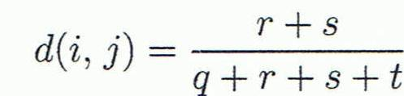
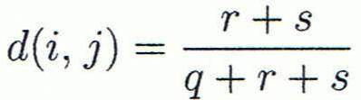

Dissimilarity for Symmetric Binary Attribute
Dissimilarity for Asymmetric Binary Attribute
then asymmetric binary similarity:
sim( i , j) =1-dis( i , j)
B R S S RAJU

Slide 23


Example: For asymmetric attribute values let the values Y (yes) and P (positive) be set to 1, and the value N (No or Negative) be set to “O”.
B R S S RAJU

Slide 24
Data Preprocessing
Data Preprocessing: An Overview
  Data Quality
  Major Tasks in Data Preprocessing
Data Cleaning
Data Integration
Data Reduction
Data Transformation and Data Discretization
Summary
B R S S RAJU

Slide 25
Data Quality: Why Preprocess the Data?
Measures for data quality: A multidimensional view
  Accuracy: correct or wrong, accurate or not
  Completeness: not recorded, unavailable, …
  Consistency: some modified but some not, dangling, …
  Timeliness: timely update?
  Believability: how trustable the data are correct?
  Interpretability: how easily the data can be understood?
B R S S RAJU

Slide 26
Major Tasks in Data Preprocessing
Data cleaning
  Fill in missing values, smooth noisy data, identify or remove outliers, and resolve inconsistencies
Data integration
  Integration of multiple databases, data cubes, or files
Data reduction
  Dimensionality reduction
  Numerosity reduction
  Data compression
Data transformation and data discretization
  Normalization
  Concept hierarchy generation
B R S S RAJU

Slide 27
Data Cleaning
Data in the Real World Is Dirty: Lots of potentially incorrect data, e.g., instrument faulty, human or computer error, transmission error
  incomplete: lacking attribute values, lacking certain attributes of interest, or containing only aggregate data
    e.g., Occupation=“ ” (missing data)
  noisy: containing noise, errors, or outliers
    e.g., Salary=“−10” (an error)
  inconsistent: containing discrepancies in codes or names, e.g.,
    Age=“42”, Birthday=“03/07/2010”
    Was rating “1, 2, 3”, now rating “A, B, C”
    discrepancy between duplicate records
  Intentional (e.g., disguised missing data)
    Jan. 1 as everyone’s birthday?
B R S S RAJU

Slide 28
Incomplete (Missing) Data
Data is not always available
  E.g., many tuples have no recorded value for several attributes, such as customer income in sales data
Missing data may be due to
  equipment malfunction
  inconsistent with other recorded data and thus deleted
  data not entered due to misunderstanding
  certain data may not be considered important at the time of entry
  not register history or changes of the data
Missing data may need to be inferred
B R S S RAJU

Slide 29
How to Handle Missing Data?
Ignore the tuple: usually done when class label is missing (when doing classification)—not effective when the % of missing values per attribute varies considerably
Fill in the missing value manually: tedious + infeasible?
Fill in it automatically with
  a global constant : e.g., “unknown”, a new class?!
  the attribute mean
  the attribute mean for all samples belonging to the same class: smarter
  the most probable value: inference-based such as Bayesian formula or decision tree
B R S S RAJU

Slide 30
Noisy Data
Noise: random error or variance in a measured variable
Incorrect attribute values may be due to
  faulty data collection instruments
  data entry problems
  data transmission problems
  technology limitation
  inconsistency in naming convention
Other data problems which require data cleaning
  duplicate records
  incomplete data
  inconsistent data
B R S S RAJU

Slide 31
Handling Noisy Data
Binning
  first sort data and partition into (equal-frequency) bins
  then one can smooth by bin means, smooth by bin median, smooth by bin boundaries, etc.
Regression
  smooth by fitting the data into regression functions
Clustering
  detect and remove outliers
Combined computer and human inspection
  detect suspicious values and check by human (e.g., deal with possible outliers)
B R S S RAJU

Slide 32
Data Integration
Data integration:
  Combines data from multiple sources into a coherent store
Schema integration: e.g., A.cust-id ≡ B.cust-#
  Integrate metadata from different sources
Entity identification problem:
  Identify real world entities from multiple data sources, e.g., Bill Clinton = William Clinton
Detecting and resolving data value conflicts
  For the same real world entity, attribute values from different sources are different
  Possible reasons: different representations, different scales, e.g., metric vs. British units
B R S S RAJU

Slide 33
Handling Redundancy in Data Integration
Redundant data occur often when integration of multiple databases
  Object identification: The same attribute or object may have different names in different databases
  Derivable data: One attribute may be a “derived” attribute in another table, e.g., annual revenue
Redundant attributes may be able to be detected by correlation analysis and covariance analysis
Careful integration of the data from multiple sources may help reduce/avoid redundancies and inconsistencies and improve mining speed and quality
B R S S RAJU

Slide 34

Correlation Analysis (Nominal Data)
Χ² (chi-square) test
The larger the Χ² value, the more likely the variables are related
The cells that contribute the most to the Χ² value are those whose actual count is very different from the expected count
Correlation does not imply causality
  # of hospitals and # of car-theft in a city are correlated
  Both are causally linked to the third variable: population
B R S S RAJU

Slide 35
Chi-Square Calculation: An Example
Χ² (chi-square) calculation (numbers in parenthesis are expected counts calculated based on the data distribution in the two categories)
It shows that like_science_fiction and play_chess are correlated in the group
 | Play chess | Not play chess | Sum (row)
Like science fiction | 250(90) | 200(360) | 450
Not like science fiction | 50(210) | 1000(840) | 1050
Sum(col.) | 300 | 1200 | 1500
B R S S RAJU

Slide 36
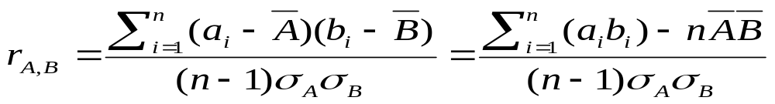
Correlation Analysis (Numeric Data)
Correlation coefficient (also called Pearson’s product moment coefficient)
  where n is the number of tuples, and are the respective means of A and B, σ_{A} and σ_{B} are the respective standard deviation of A and B, and Σ(a_{i}b_{i}) is the sum of the AB cross-product.
If r_{A,B} > 0, A and B are positively correlated (A’s values increase as B’s). The higher, the stronger correlation.
r_{A,B} = 0: independent; r_{AB} < 0: negatively correlated.
B R S S RAJU

Slide 37



Covariance (Numeric Data)
Covariance is similar to correlation
  where n is the number of tuples, and are the respective mean or expected values of A and B, σ_{A} and σ_{B} are the respective standard deviation of A and B.
Positive covariance: If Cov_{A,B} > 0, then A and B both tend to be larger than their expected values.
Negative covariance: If Cov_{A,B} < 0 then if A is larger than its expected value, B is likely to be smaller than its expected value.
Independence: Cov_{A,B} = 0 but the converse is not true:
  Some pairs of random variables may have a covariance of 0 but are not independent. Only under some additional assumptions (e.g., the data follow multivariate normal distributions) does a covariance of 0 imply independence
B R S S RAJU

Slide 38

Co-Variance: An Example
It can be simplified in computation as
Suppose two stocks A and B have the following values in one week: (2, 5), (3, 8), (5, 10), (4, 11), (6, 14)
Question: If the stocks are affected by the same industry trends, will their prices rise or fall together?
  E(A) = (2 + 3 + 5 + 4 + 6)/ 5 = 20/5 = 4
  E(B) = (5 + 8 + 10 + 11 + 14) /5 = 48/5 = 9.6
  Cov(A,B) = (2×5+3×8+5×10+4×11+6×14)/5 − 4 × 9.6 = 4
Thus, A and B rise together since Cov(A, B) > 0.
B R S S RAJU

Slide 39
Data Reduction Strategies
Data reduction: Obtain a reduced representation of the data set that is much smaller in volume but produces the same (or almost the same) analytical results
Why data reduction? — A database/data warehouse may store terabytes of data. Complex data analysis may take a very long time to run on the complete data set.
Data reduction strategies
  Dimensionality reduction, e.g., remove unimportant attributes
    Wavelet transforms
    Principal Components Analysis (PCA)
    Feature subset selection, feature creation
  Numerosity reduction (some simply call it: Data Reduction)
    Regression and Log-Linear Models
    Histograms, clustering, sampling
    Data cube aggregation
  Data compression
B R S S RAJU

Slide 40
Data Reduction 1: Dimensionality Reduction
Curse of dimensionality:
  When dimensionality increases, data becomes increasingly sparse
  Density and distance between points, which is critical to clustering, outlier analysis, becomes less meaningful
  The possible combinations of subspaces will grow exponentially
Dimensionality reduction:
  Avoid the curse of dimensionality
  Help eliminate irrelevant features and reduce noise
  Reduce time and space required in data mining
  Allow easier visualization
Dimensionality reduction techniques:
  Wavelet transforms
  Principal Component Analysis
  Supervised and nonlinear techniques (e.g., feature selection)
B R S S RAJU

Slide 41

What Is Wavelet Transform?
Decomposes a signal into different frequency sub bands
  Applicable to n-dimensional signals
Data are transformed to preserve relative distance between objects at different levels of resolution
Allow natural clusters to become more distinguishable
Used for image compression
B R S S RAJU

Slide 42
Wavelet Transformation
Haar2
Daubechie4
Discrete wavelet transform (DWT) for linear signal processing, multi-resolution analysis
Compressed approximation: store only a small fraction of the strongest of the wavelet coefficients
Similar to discrete Fourier transform (DFT), but better lossy compression, localized in space
Method:
  Length, L, must be an integer power of 2 (padding with 0’s, when necessary)
  Each transform has 2 functions: smoothing, difference
  Applies to pairs of data, resulting in two set of data of length L/2
  Applies two functions recursively, until reaches the desired length
B R S S RAJU

Slide 43

Wavelet Decomposition
Wavelets: A math tool for space-efficient hierarchical decomposition of functions
S = [2, 2, 0, 2, 3, 5, 4, 4] can be transformed to S^ = [2³/₄, -1¹/₄, ¹/₂, 0, 0, -1, -1, 0]
Compression: many small detail coefficients can be replaced by 0’s, and only the significant coefficients are retained
B R S S RAJU

Slide 44
Haar Wavelet Coefficients
Coefficient “Supports”
₊
Hierarchical decomposition structure (a.k.a. “error tree”)
2.75
₋
2.75
₊
+
-1.25
₋
+
-1.25
-
₊
0.5
₋
0.5
0
₊
+
-
+
-
0
₋
0
-1
-1
0
₊
0
₋
+
-
+
-
+
-
+
-
₊
₋
-1
2 2 0 2 3 5 4 4
₊
-1
₋
₊
Original frequency distribution
0
B R S S RAJU

Slide 45
Why Wavelet Transform?
Use hat-shape filters
  Emphasize region where points cluster
  Suppress weaker information in their boundaries
Effective removal of outliers
  Insensitive to noise, insensitive to input order
Multi-resolution
  Detect arbitrary shaped clusters at different scales
Efficient
  Complexity O(N)
Only applicable to low dimensional data
B R S S RAJU

Slide 46
Principal Component Analysis (PCA)
Find a projection that captures the largest amount of variation in data
The original data are projected onto a much smaller space, resulting in dimensionality reduction. We find the eigenvectors of the covariance matrix, and these eigenvectors define the new space
x₂
e
x₁
B R S S RAJU

Slide 47
Principal Component Analysis (Steps)
Given N data vectors from n-dimensions, find k ≤ n orthogonal vectors (principal components) that can be best used to represent data
  Normalize input data: Each attribute falls within the same range
  Compute k orthonormal (unit) vectors, i.e., principal components
  Each input data (vector) is a linear combination of the k principal component vectors
  The principal components are sorted in order of decreasing “significance” or strength
  Since the components are sorted, the size of the data can be reduced by eliminating the weak components, i.e., those with low variance (i.e., using the strongest principal components, it is possible to reconstruct a good approximation of the original data)
Works for numeric data only
B R S S RAJU

Slide 48
Attribute Subset Selection
Another way to reduce dimensionality of data
Redundant attributes
  Duplicate much or all of the information contained in one or more other attributes
  E.g., purchase price of a product and the amount of sales tax paid
Irrelevant attributes
  Contain no information that is useful for the data mining task at hand
  E.g., students' ID is often irrelevant to the task of predicting students' GPA.
B R S S RAJU

Slide 49
Heuristic Search in Attribute Selection
There are 2^{d} possible attribute combinations of d attributes
Typical heuristic attribute selection methods:
  Best single attribute under the attribute independence assumption: choose by significance tests
  Best step-wise feature selection:
    The best single-attribute is picked first
    Then next best attribute condition to the first, ...
  Step-wise attribute elimination:
    Repeatedly eliminate the worst attribute
  Best combined attribute selection and elimination
  Optimal branch and bound:
    Use attribute elimination and backtracking
B R S S RAJU

Slide 50
Attribute Creation (Feature Generation)
Create new attributes (features) that can capture the important information in a data set more effectively than the original ones
Three general methodologies
  Attribute extraction
    Domain-specific
  Mapping data to new space (see: data reduction)
    E.g., Fourier transformation, wavelet transformation, manifold approaches (not covered)
  Attribute construction
    Combining features (see: discriminative frequent patterns in Chapter 7)
    Data discretization
B R S S RAJU

Slide 51
Data Reduction 2: Numerosity Reduction
Reduce data volume by choosing alternative, smaller forms of data representation
Parametric methods (e.g., regression)
  Assume the data fits some model, estimate model parameters, store only the parameters, and discard the data (except possible outliers)
  Ex.: Log-linear models—obtain value at a point in m-D space as the product on appropriate marginal subspaces
Non-parametric methods
  Do not assume models
  Major families: histograms, clustering, sampling, …
B R S S RAJU

Slide 52
Parametric Data Reduction: Regression and Log-Linear Models
Linear regression
  Data modeled to fit a straight line
  Often uses the least-square method to fit the line
Multiple regression
  Allows a response variable Y to be modeled as a linear function of multidimensional feature vector
Log-linear model
  Approximates discrete multidimensional probability distributions
B R S S RAJU

Slide 53
Regression Analysis
y
Y1
Regression analysis: A collective name for techniques for the modeling and analysis of numerical data consisting of values of a dependent variable (also called response variable or measurement) and of one or more independent variables (aka. explanatory variables or predictors)
The parameters are estimated so as to give a "best fit" of the data
Most commonly the best fit is evaluated by using the least squares method, but other criteria have also been used
Y1’
y = x + 1
X1
x
Used for prediction (including forecasting of time-series data), inference, hypothesis testing, and modeling of causal relationships
B R S S RAJU

Slide 54
Data Cube Aggregation
The lowest level of a data cube (base cuboid)
  The aggregated data for an individual entity of interest
  E.g., a customer in a phone calling data warehouse
Multiple levels of aggregation in data cubes
  Further reduce the size of data to deal with
Reference appropriate levels
  Use the smallest representation which is enough to solve the task
Queries regarding aggregated information should be answered using data cube, when possible
B R S S RAJU

Slide 55
Data Reduction 3: Data Compression
String compression
  There are extensive theories and well-tuned algorithms
  Typically lossless, but only limited manipulation is possible without expansion
Audio/video compression
  Typically lossy compression, with progressive refinement
  Sometimes small fragments of signal can be reconstructed without reconstructing the whole
Time sequence is not audio
  Typically short and vary slowly with time
Dimensionality and numerosity reduction may also be considered as forms of data compression
B R S S RAJU

Slide 56
Data Compression
Original Data
Compressed
Data
lossless
lossy
Original Data
Approximated
B R S S RAJU

Slide 57
Data Transformation
A function that maps the entire set of values of a given attribute to a new set of replacement values s.t. each old value can be identified with one of the new values
Methods
  Smoothing: Remove noise from data
  Attribute/feature construction
    New attributes constructed from the given ones
  Aggregation: Summarization, data cube construction
  Normalization: Scaled to fall within a smaller, specified range
    min-max normalization
    z-score normalization
    normalization by decimal scaling
  Discretization: Concept hierarchy climbing
B R S S RAJU

Slide 58
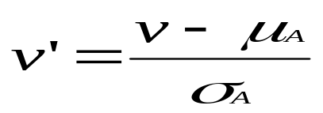

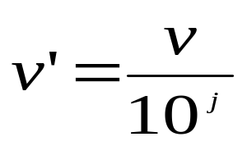
Normalization
Min-max normalization: to [new_min_{A}, new_max_{A}]
  Ex. Let income range $12,000 to $98,000 normalized to [0.0, 1.0]. Then $73,000 is mapped to
Z-score normalization (μ: mean, σ: standard deviation):
  Ex. Let μ = 54,000, σ = 16,000. Then
Normalization by decimal scaling
Where j is the smallest integer such that Max(|ν’|) < 1
B R S S RAJU

Slide 59
Data Discretization Methods
Typical methods: All the methods can be applied recursively
  Binning
    Top-down split, unsupervised
  Histogram analysis
    Top-down split, unsupervised
  Clustering analysis (unsupervised, top-down split or bottom-up merge)
  Decision-tree analysis (supervised, top-down split)
  Correlation (e.g., χ²) analysis (unsupervised, bottom-up merge)
B R S S RAJU

Slide 60
Simple Discretization: Binning
Equal-width (distance) partitioning
  Divides the range into N intervals of equal size: uniform grid
  if A and B are the lowest and highest values of the attribute, the width of intervals will be: W = (B –A)/N.
  The most straightforward, but outliers may dominate presentation
  Skewed data is not handled well
Equal-depth (frequency) partitioning
  Divides the range into N intervals, each containing approximately same number of samples
  Good data scaling
  Managing categorical attributes can be tricky
B R S S RAJU

Slide 61
Binning Methods for Data Smoothing
Sorted data for price (in dollars): 4, 8, 9, 15, 21, 21, 24, 25, 26, 28, 29, 34
* Partition into equal-frequency (equi-depth) bins:
- Bin 1: 4, 8, 9, 15
- Bin 2: 21, 21, 24, 25
- Bin 3: 26, 28, 29, 34
* Smoothing by bin means:
- Bin 1: 9, 9, 9, 9
- Bin 2: 23, 23, 23, 23
- Bin 3: 29, 29, 29, 29
* Smoothing by bin boundaries:
- Bin 1: 4, 4, 4, 15
- Bin 2: 21, 21, 25, 25
- Bin 3: 26, 26, 26, 34
B R S S RAJU

Slide 62
Concept Hierarchy Generation
Concept hierarchy organizes concepts (i.e., attribute values) hierarchically and is usually associated with each dimension in a data warehouse
Concept hierarchies facilitate drilling and rolling in data warehouses to view data in multiple granularity
Concept hierarchy formation: Recursively reduce the data by collecting and replacing low level concepts (such as numeric values for age) by higher level concepts (such as youth, adult, or senior)
Concept hierarchies can be explicitly specified by domain experts and/or data warehouse designers
Concept hierarchy can be automatically formed for both numeric and nominal data. For numeric data, use discretization methods shown.
B R S S RAJU

Slide 63
Concept Hierarchy Generation
for Nominal Data
Specification of a partial/total ordering of attributes explicitly at the schema level by users or experts
  street < city < state < country
Specification of a hierarchy for a set of values by explicit data grouping
  {Urbana, Champaign, Chicago} < Illinois
Specification of only a partial set of attributes
  E.g., only street < city, not others
Automatic generation of hierarchies (or attribute levels) by the analysis of the number of distinct values
  E.g., for a set of attributes: {street, city, state, country}
B R S S RAJU

Slide 64
Automatic Concept Hierarchy Generation
Some hierarchies can be automatically generated based on the analysis of the number of distinct values per attribute in the data set
  The attribute with the most distinct values is placed at the lowest level of the hierarchy
  Exceptions, e.g., weekday, month, quarter, year
country
15 distinct values
province_or_ state
365 distinct values
city
3567 distinct values
street
674,339 distinct values
B R S S RAJU

